Slide 1
Chapter 5: CPU Scheduling: The Gantt Chart for the schedule, turnaround time, waiting time )
FCFS
SJF
SRTF
RR
Chapter 8: Deadlocks
Banker’s Algorithm

Slide 2
Consider the following snapshot of a system with 4 types of resources: 9 A, 9 B, 8 C, 6 D. What is the content of the matrix Need? Is the system in a safe state?
Process | Allocation A B C D | Max A B C D
P1 | 1 2 0 1 | 4 4 1 1
P2 | 1 0 1 1 | 7 5 6 2
P3 | 1 1 1 1 | 3 2 5 1
P4 | 2 2 0 1 | 4 2 3 1
P5 | 0 2 0 1 | 7 4 5 2
 | A | B | C | D
P1 | 4 | 2 | 6 | 1
P2 | 5 | 4 | 6 | 2 P1
P3 | 6 | 5 | 7 | 3 P3
P4 | 8 | 7 | 7 | 4 P4
P5 | 8 | 9 | 7 | 5 P5
 | 9 | 9 | 8 | 6 P2
 | A | B | C | D
P1 | 3 | 2 | 1 | 0
P2 | 6 | 5 | 5 | 1
P3 | 2 | 1 | 4 | 0
P4 | 2 | 0 | 3 | 0
P5 | 7 | 2 | 5 | 1

Slide 3
Available
Need
Safe state: P1 → P3 → P4 → P5 → P2
A | B | C | D
4 | 2 | 6 | 1
 | A | B | C | D
P1 | 3 | 2 | 1 | 0
P2 | 6 | 5 | 5 | 1
P3 | 2 | 1 | 4 | 0
P4 | 2 | 0 | 3 | 0
P5 | 7 | 2 | 5 | 1

Slide 4
Assume that you have following processes, their arrival times and burst times. For FCFS scheduling algorithms, determine the waiting times for each process and the average waiting times.
Job | Arrival Time | CPU burst
J1 | 0 | 5
J2 | 3 | 6
J3 | 4 | 8
J4 | 10 | 4
J5 | 12 | 1
J6 | 15 | 3
 |  | J1 |  |  |  |  | J2 |  |  |  |  |  |  |  | J3 |  |  |  |  | J4 |  |  | J5 |  | J6

Slide 5
FCFS
 |  | J1 |  |  |  |  | J2 |  |  |  |  |  |  |  | J3 |  |  |  |  | J4 |  |  | J5 |  | J6
Job | Thời gian chờ | Thời gian hoàn thành
J1 | 0 | 5 – 0 = 5
J2 | 5 – 3 = 2 | 11 – 3 = 8
J3 | 11 – 4 = 7 | 19 – 4 = 15
J4 | 19 – 10 = 9 | 23 – 10 = 13
J5 | 23 – 12 = 11 | 24 – 12 = 12
J6 | 24 – 15 = 9 | 27 – 15 = 12
Trung Bình | 6.33 | 10.83

Slide 6
Assume that you have following processes, their arrival times and burst times. For SJF non-preemptive scheduling algorithms, determine the waiting times for each process and the average waiting times.
Job | Arrival Time | CPU burst
J1 | 0 | 5
J2 | 3 | 6
J3 | 4 | 8
J4 | 10 | 4
J5 | 12 | 1
J6 | 15 | 3
 |  | J1 |  |  |  |  | J2 |  |  |  |  |  | J4 |  | J5 |  | J6 |  |  |  |  | J3

Slide 7
SJF(Non-Preemtive)
 |  | J1 |  |  |  |  | J2 |  |  |  |  |  | J4 |  | J5 |  | J6 |  |  |  |  | J3
Job | Thời gian chờ | Thời gian hoàn thành
J1 | 0 | 5 – 0 = 5
J2 | 5 – 3 = 2 | 11 – 3 = 8
J3 | 19 – 4 = 15 | 27 – 4 = 23
J4 | 11 – 10 = 1 | 15 – 10 = 5
J5 | 15 – 12 = 3 | 16 – 12 = 4
J6 | 16 – 15 = 1 | 19 – 15 = 4
Trung Bình | 3.67 | 8.167

Slide 8
Chapter 9: Main Memory
1.
First-fit: Allocate the first hole that is big enough
Best-fit: Allocate the smallest hole that is big enough; must search entire list, unless ordered by size
  Produces the smallest leftover hole
Worst-fit: Allocate the largest hole; must also search entire list
  Produces the largest leftover hole.
  2.
Consider a logical address space of eight pages of 1024 words each, mapped onto a physical memory of 32 frames.
How many bits are there in the logical address?
b. How many bits are there in the physical address?

Slide 9
. Given five memory partitions of 100 KB, 500 KB, 200 KB, 300 KB, and 600 KB (in order), how would each of the First-fit, Best-fit and worst fit place processes of 210 KB, 415 KB, 100 KB, and 586 KB (in order)?
First-fit
100, 500, 200, 300, 600
P1(210) 100, 290,200, 300, 600
P2(415) 100, 290, 200, 300, 185
P3(100) 0, 290, 200, 300, 185
P4(586) Wait
Best-fit
100, 500, 200, 300, 600
P1(210) 100, 500, 200, 90, 600
P2(415) 100, 85, 200, 90, 600
P3(100) 0, 85, 200, 90, 600
P4(586) 0, 85, 200, 90, 14
1
Worst-fit
100, 500, 200, 300, 600
P1(210) 100, 500, 200, 300, 390
P2(415) 100, 85, 200, 300, 390
P3(100) 100, 85, 200, 300, 290
P4(586) wait

Slide 10
Consider the following segment table
What are the physical addresses for the following logical addresses: 0.31; 1.300; 2.10; 3.678; 4.1025
Segment | Base | Limit
0 | 114 | 64
1 | 400 | 200
2 | 1200 | 19
3 | 1540 | 800
4 | 1300 | 768

Slide 11
0,31
114 + 31 = 145
1,300
Illegal address
2,10
1200 + 10 = 1210
3,678
1540 + 678 = 2218
4,1025
Illegal address

Slide 12
What are the physical addresses in the multi-partition for the following addresses:
115, 256, 2048, 300, 512, 3002, 3000, 6234, 1024, 1111. The base register is 0x2357, the limit register is 5120.

Slide 13
Thanh ghi nền: 0x2357 = 9047 = 2*16^3+3*16^2+5*16+7, thanh ghi giới hạn: 5120
115
9047 + 115 = 9162
256
9047 + 256 = 9303
2048
9047 + 2048 = 11095
300
9047 + 300 = 9347
512
9047 + 512 = 9559
3002
9047 + 3002 = 12049
3000
9047 + 3000 = 12047
6234
Illegal Address
1024
9047 + 1024 = 10071
1111
9047 + 1111 = 10158

Slide 14
Chapter 10: Virtual Memory

Slide 15
First-In-First-Out (FIFO) Algorithm
Reference string: 7,0,1,2,0,3,0,4,2,3,0,3,0,3,2,1,2,0,1,7,0,1
3 frames (3 pages can be in memory at a time per process)

Slide 16
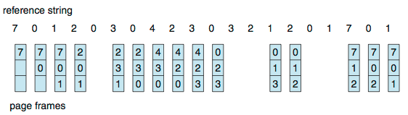
First-In-First-Out (FIFO) Algorithm
Reference string: 7,0,1,2,0,3,0,4,2,3,0,3,0,3,2,1,2,0,1,7,0,1
3 frames (3 pages can be in memory at a time per process)
Can vary by reference string: consider 1,2,3,4,1,2,5,1,2,3,4,5
  Adding more frames can cause more page faults!
    Belady’s Anomaly
How to track ages of pages?
  Just use a FIFO queue
15 page faults

Slide 17
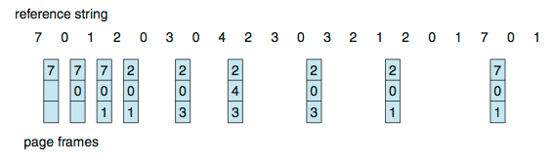
Optimal Algorithm (OPT)
Replace page that will not be used for longest period of time
  9 is optimal for the example
How do you know this?
  Can’t read the future
Used for measuring how well your algorithm performs

Slide 18
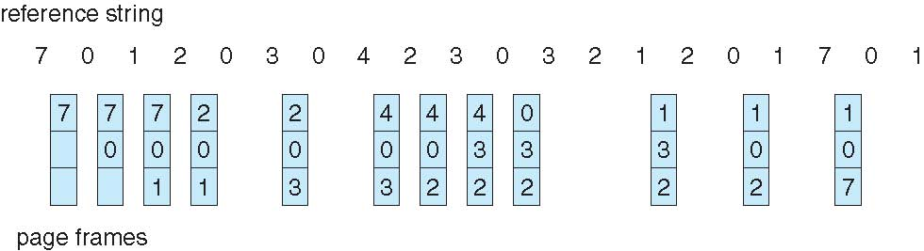
Least Recently Used (LRU) Algorithm
Use past knowledge rather than future
Replace page that has not been used in the most amount of time
Associate time of last use with each page
12 faults – better than FIFO but worse than OPT
Generally good algorithm and frequently used
But how to implement?

